Slide 1
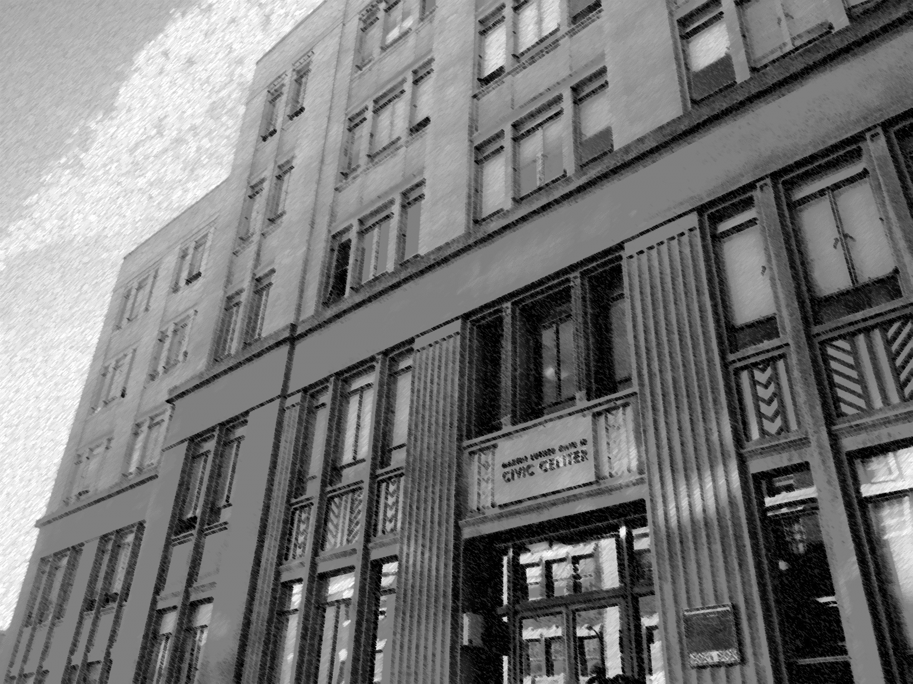
Community Survey RESULTS &
Potential Ballot Measures for
NovEMBER 2024
Special City Council Meeting
June 14, 2024

Slide 2
Community Survey RESULTS & Potential Ballot Measures for NovEMBER 2024
The following community-sponsored ballot measures have either qualified or are in the process of qualifying for the November, 2024 election:
CAFO Prohibition (Council Action on 11/7/23) Placed on Nov 2024 ballot
SAFE STREETS Initiative Tax (Mirvish/Gould/Yung) Qualified for Nov 2024 ballot
Fix Streets & Sidewalks Initiative Tax (McGrath) Qualified for Nov 2024 ballot
Infectious Aerosols Ord. (Lippman/Law/Soper) Qualified for Nov 2024 ballot
Fossil Fuels Tax (Lippman/Tahara/Lieblich) Qualified for Nov 2024 ballot
Rent Relief & Homeowners (Clement/Lieberman) Qualified for Nov 2024 ballot
Tenants Ordinance (Alpert/Simon-Weisberg) In circulation
Nuclear Free Amendments (Pittman) In circulation

Slide 3
Community Survey RESULTS & Potential Ballot Measures for NovEMBER 2024
TIMELINE
City Council action on the Parks Tax, Measure P, and Arts Measure is needed today in order for City staff to have sufficient time to draft final ballot language and return to Council at the July 30, 2024 meeting.
June 5, 2024 – Completion of the Community Survey.
June 14, 2024 – Presentation on community survey results at Council and decision on what goes on ballot.
June 15 - July 17, 2024 – Staff time to produce final ballot language.
July 25, 2024 – Publishing deadline for the July 30, 2024 Special Council meeting agenda.
July 30, 2024 – Potential Special Council meeting (3:00pm) for formal action to place the measures on the November 2024 ballot.
August 9, 2024 – deadline by which the adopted and signed resolutions that contain the exact text of the measure and the 75-word ballot question must be delivered to the Alameda County Registrar of Voters Office.

Slide 4
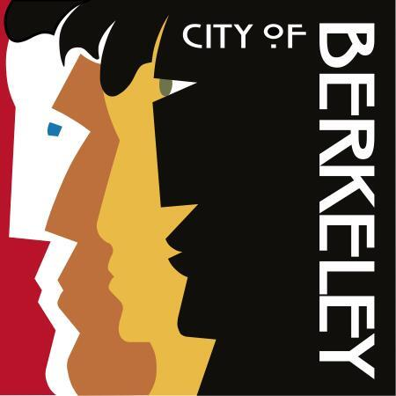
City of Berkeley
Findings from a community survey of 500 likely 2024 voters
May 30 - June 4, 2024
David Mermin
Nikolai Schweber

Slide 5
Methodology
Lake Research Partners designed and administered this survey, which was conducted by live telephone interview and text-to-online.
The survey reached a total of 500 likely November 2024 election voters in Berkeley, California.
The survey was conducted May 30 - June 4, 2024.
Data were weighted slightly by gender, region, age, race, party registration, homeownership, and education to reflect the expected demographic composition of likely November election voters in Berkeley.
The margin of error for the full sample is +/-4.4%.

Slide 6
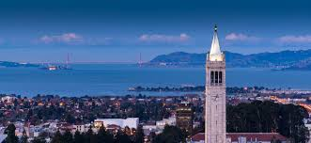
Context

Slide 7
The highest priority for Berkeley voters is increasing affordable housing for low-income and homeless residents. Other major priorities include repairing deteriorating streets and sidewalks and improving pedestrian, bike, and traffic safety.
Top Issues in the City of Berkeley
Q5. [T*] Now I’m going to read some different issues that have been identified as important needs in the city of Berkeley. If you had to choose, which one or two of the following would be the highest priority for you personally in the city of Berkeley? [RANDOMIZE]

Slide 8
Almost half of Berkeley voters think that things in Berkeley are going in the right direction, while one in three think things are going in the wrong direction and the rest are uncertain. Negativity has slightly increased while positivity has held steady.
Do you think that things in Berkeley are going in the right direction, or do you feel things are off on the wrong track?
Q3. [T*] Do you feel that the City of Berkeley is generally headed in the right direction or do you feel things are headed in the wrong direction?

Slide 9
Over half of Berkeley residents (54%) think the city is doing a good or excellent job providing services to residents, including 8% who say it is doing an excellent job. About four in ten say the city is doing a just fair or poor job.
City of Berkeley Job Performance: Providing Services to Residents
 | Good |  | Fair
 | Excellent |  | Poor
Q4. [T] How would you rate the job the city of Berkeley is doing in providing services to its residents — excellent, good, fair, or poor?

Slide 10

Parks Tax

Slide 11
Parks Tax Intro
This is a ballot measure that would provide funding through an increase in Berkeley’s existing parks tax in order to: • Establish a city-wide tree planting unit to plant trees throughout the city; • Provide increased annual funding for physical improvements in city parks; and • Apply the city’s parks budget to all parks, including the Berkeley waterfront which currently doesn’t receive parks tax funding.

Slide 12
Text of Ballots – Parks Tax
[PARKS TAX – 20%] Shall the measure increasing the rate of the City’s existing special tax for parks, trees, and landscaping maintenance from $0.2130 to $0.2556 per square foot (of taxable improvements), generating an estimated additional $3.7 million annually for a total of $22 million annually, be adopted?
[PARKS TAX – 28%] Shall the measure increasing the rate of the City’s existing special tax for parks, trees, and landscaping maintenance from $0.2130 to $0.2726 per square foot (of taxable improvements), generating an estimated additional $5.1 million annually for a total of $23.4 million annually, be adopted?

Slide 13
The 20% parks tax increase narrowly surpasses the 2/3 Yes vote threshold to pass, while the 28% version falls short by several points. The No vote and undecided vote are both slightly higher on the larger increase.
20% Parks Tax Increase
28% Parks Tax Increase
+49
2/3 Yes Threshold
+41
Both Ballots Split-Sampled
 | Yes – not so strongly/lean yes |  | No – not so strongly/lean no
 | Yes – strongly |  | No– strongly
Q6/7. […] If the election were held today, would you vote yes or no on this measure, or are you undecided? [IF YES/NO]: And is that Yes/No strongly or not so strongly? [IF UNDECIDED]: Well, to which side do you lean?

Slide 14
Parks Tax: Supporter/Opponent Statements
Supporters say that Berkeley’s parks and trees are vital for our communities, families, seniors, mental health, clean environment, and climate resilience. This modest funding increase will address the need to plant and maintain trees and improve green spaces and parks facilities in every neighborhood with the growing threat of climate change. This modest funding increase will address these needs in all areas of the city, including parks and landscaped areas at the waterfront that are not currently funded by the parks budget, and improve facilities for everyone in Berkeley.
Opponents say that Berkeley taxpayers keep getting soaked for more and more increases with little to show for it. We funded streets, and the streets are still a mess. We funded housing, and housing costs and homelessness are worse than ever. This measure will funnel our tax money to benefit wealthy boat owners who use the waterfront, not the rest of us in Berkeley. We need to look more closely at this high-tax, high-cost city government, cut wasteful and unnecessary spending, and clean up our parks with existing funds.

Slide 15
After balanced messaging from both sides, the smaller 20% parks tax increase falls a few points below the 2/3 threshold needed to pass while the 28% increase remains at a similar level, also below the threshold.
20% Parks Tax Increase: Informed
28% Parks Tax Increase: Informed
+39
+33
2/3 Yes Threshold
Both Ballots Split-Sampled
Q11/12. […] Sometimes in a survey like this, people change their minds. If the election were held today, would you vote yes or no on this measure, or are you undecided? [IF YES/NO]: And is that Yes/No strongly or not so strongly? [IF UNDECIDED]: Well, to which side do you lean?
 | Yes – not so strongly/lean yes |  | No – not so strongly/lean no
 | Yes – strongly |  | No– strongly

Slide 16
Real Estate Transfer Tax for Homeless Services

Slide 17
Full Text of Ballots – Real Estate Transfer Tax
[HOMELESS EXTENSION W/ TIERED INCREASE ] This is a ballot measure that would extend, and increase for some higher-value properties, the time-limited real estate transfer tax voters approved in 2018 to fund homeless services. Shall the measure setting the existing tax for general government use on transfers of real property at 2.5% of a property’s value for properties valued $1.5M or higher, and increasing the rate from 2.5% to 3% for properties valued $3M or higher, and increasing the rate from 2.5% to 3.5% for properties valued $10M or higher; removing its January 2029 expiration date; generating an estimated additional $2M to $4M for a total of $9M to $11M annually, be adopted?
[HOMELESS EXTENSION – NO INCREASE] This is a ballot measure that would extend, but not increase, the time-limited real estate transfer tax voters approved in 2018 to fund homeless services. Shall the measure setting the existing tax for general government use on transfers of real property at 2.5% of a property’s value for properties valued $1.5M or higher and removing its January 2029 expiration date estimated to generate $7-$9M annually, be adopted?

Slide 18
Both versions of the real estate transfer tax exceed the majority threshold to pass by a significant margin, with support from six in ten voters. The version with the tiered increase receives slightly higher support from voters than the version with no increase.
Tiered Increase
No Increase
+37
+35
1/2 Yes Threshold
 | Yes – not so strongly/lean yes |  | No – not so strongly/lean no
 | Yes – strongly |  | No– strongly
Q8/9. […] If the election were held today, would you vote yes or no on this measure, or are you undecided? [IF YES/NO]: And is that Yes/No strongly or not so strongly? [IF UNDECIDED]: Well, to which side do you lean?

Slide 19
Real Estate Transfer Tax: Supporter/Opponent Statements
Supporters say that Berkeley has made real progress on homelessness, especially encampments, with the funding approved in 2018. The funding approved in 2018 has leveraged over $10 million in state and other outside funding, enabling the City to triple the number of beds dedicated to people living in encampments and permanently house over 1,500 people. The current funding is providing measurable results, and extending and increasing this funding now will continue to build upon this success by helping address rising program costs. This modest funding will address these needs in all areas of the city and improve Berkeley’s quality of life for all.
Opponents say that Berkeley taxpayers keep getting soaked for more and more increases with little to show for it. We funded streets, and the streets are still a mess. We funded housing, and housing costs and homelessness are worse than ever. We need to look more closely at this high-tax, high-cost city government, cut wasteful and unnecessary spending, and fund homeless services and housing with existing funds.

Slide 20
After balanced messaging from both sides, support for both versions of the real-estate transfer tax holds steady with minimal shifts.
Tiered Increase
No Increase
+36
+37
1/2 Yes Threshold
Q13/14. […] Sometimes in a survey like this, people change their minds. If the election were held today, would you vote yes or no on this measure, or are you undecided? [IF YES/NO]: And is that Yes/No strongly or not so strongly? [IF UNDECIDED]: Well, to which side do you lean?
 | Yes – not so strongly/lean yes |  | No – not so strongly/lean no
 | Yes – strongly |  | No– strongly

Slide 21
Arts Measure

Slide 22
Arts Measure Intro
This measure would advise the Mayor to work with residents and experts in developing a general “performing arts rescue and maintenance” revenue package to support performing arts institutions and programs in Berkeley, expand performing arts education activities in Berkeley’s public schools, culturally-diverse arts programs, festivals and street fairs, and capital projects for arts.

Slide 23
The proposed arts funding measure, which did not include details about taxes or revenue amounts, received a positive response from just over two-thirds of voters.
Arts Measure
+52
 | Yes – not so strongly/lean yes |  | No – not so strongly/lean no
 | Yes – strongly |  | No– strongly
Q10. If the election were held today, would you vote yes or no on this measure, or are you undecided? [IF YES/NO]: And is that Yes/No strongly or not so strongly? [IF UNDECIDED]: Well, to which side do you lean?

Slide 24


Washington, DC | Berkeley, CA | New York, NY
LakeResearch.com
202.776.9066
David Mermin
dmermin@lakeresearch.com
Nikolai Schweber
nschweber@lakeresearch.com

Slide 25
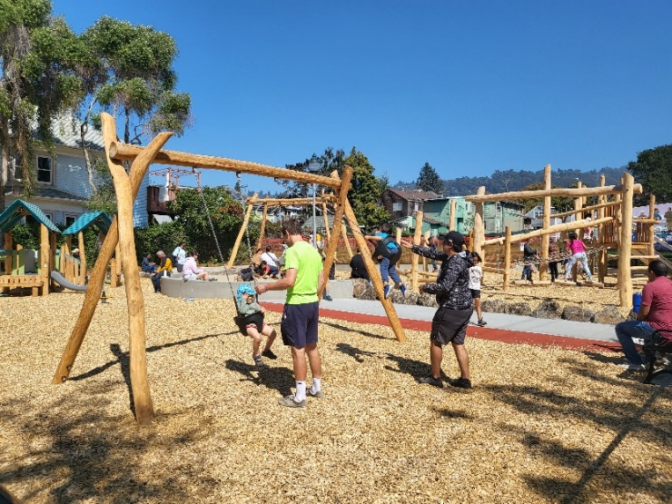
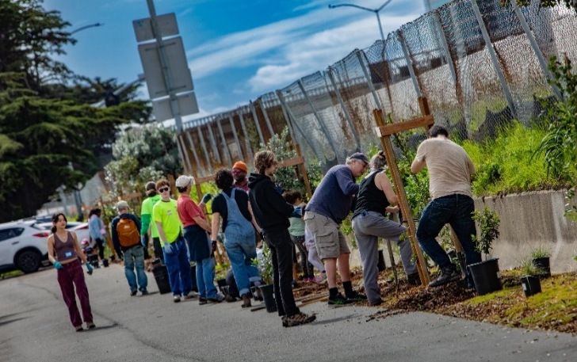
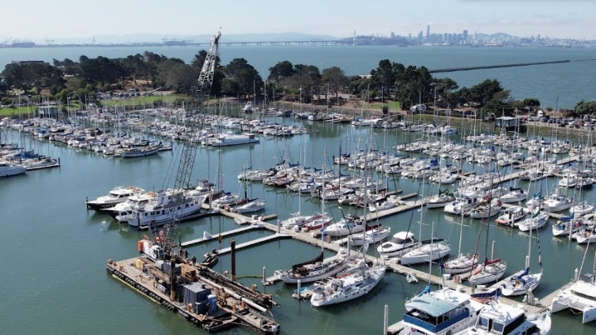
Community Survey RESULTS & Potential Ballot Measures for NovEMBER 2024
Parks Tax Ballot Measure Options:
      Percent Increase New Annual Revenue New Total Revenue
20%: $3.52M $22.3M
  28%: $5.1M $23.4M

Slide 26
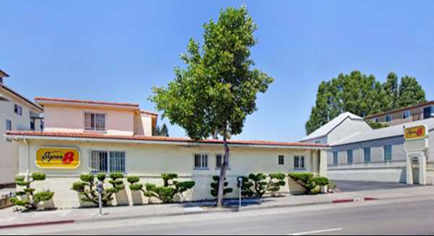
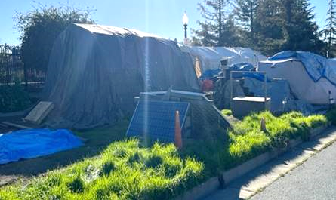
Community Survey RESULTS & Potential Ballot Measures for NoVEMBER 2024
  Homeless Services Tax Options (Measure P)
    Extension and Increase: The proposed ballot measure will make the following change:
      for values of $3M or higher, the rate increase from 2.5% to 3%;
      for values of $10M or higher, the rate increases from 2.5% to 3.5%; and
      the January 1, 2029 expiration date will be removed.
    Extension Only: The proposed ballot measure will make the following change:
      the January 1, 2029 expiration date will be removed.

Slide 27
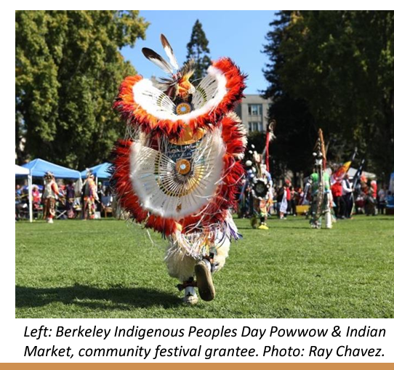
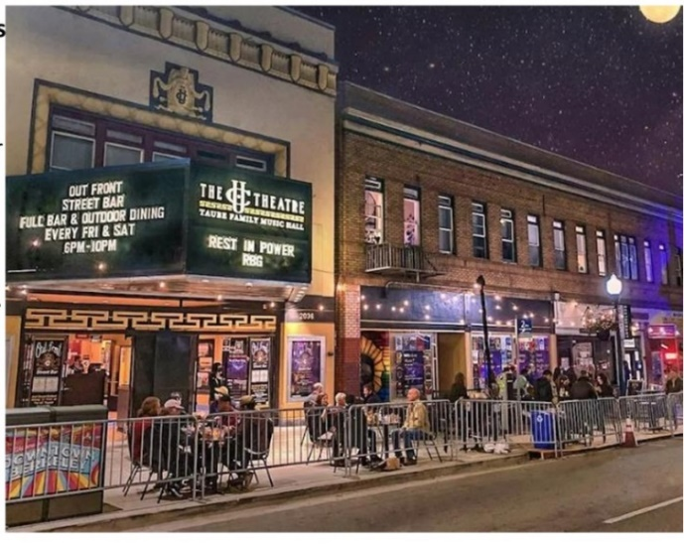
Community Survey RESULTS & Potential Ballot Measures for NovEMBER 2024
  Arts Ballot Measure Option (new).
  This measure would advise the Mayor to work with residents and experts in developing a general “performing arts rescue and maintenance” revenue package to support performing arts institutions and programs in Berkeley, expand performing arts education activities in Berkeley’s public schools, culturally-diverse arts programs, festivals and street fairs, and capital projects for arts.

Slide 28
Community Survey RESULTS & Potential Ballot Measures for NovEMBER 2024
  Direction requested on the following:
  Proceed with ballot measure language for the revenue measures presented?
  If direction is to proceed with Parks Tax:
  Select an option:
    20%
    28%
  If direction is to proceed with Homeless Services Tax (Measure P):
  Select an option:
    Extension & Increase
    Extension Only

Slide 29
Community Survey RESULTS & Potential Ballot Measures for NovEMBER 2024
  Arts Ballot Measure – Considerations & Options
  Revenue vehicle not yet identified, as with other measures
  Option 1: Direct staff to conduct additional surveying specifying the potential tax:
    Transit Occupancy Tax (TOT)
    Sales Tax
    Parcel Tax
  Consider arts measure for a future special or regular election
  Option 2: Select a revenue option now and give staff direction to proceed with drafting ballot measure for November 2024 election

Slide 30
Community Survey RESULTS & Potential Ballot Measures for NovEMBER 2024
QUESTIONS?

