Slide 1


West Berkeley Aquatic Park Stormwater Improvement Project
December 12, 2024
RICARDO SALCEDO PE, CITY OF BERKELEY – PROJECT MANAGER

Slide 2
General Project Info
Grant funded water quality improvement project which includes the following:
Green infrastructure adjacent to Dreamland Playground
Trash capture infrastructure on Channing and Bancroft way east of UPRR corridor
Storm drainage improvements along Bancroft
EPA SF Bay Water Quality Improvement Fund (SFBWQIF)
Competitive grant program focused on improving the water quality of San Francisco Bay
City submitted an application for funding in 2023, was selected, and Council accepted funding on June 25, 2024.
$1.5M with a local match of $1.5M

Slide 3
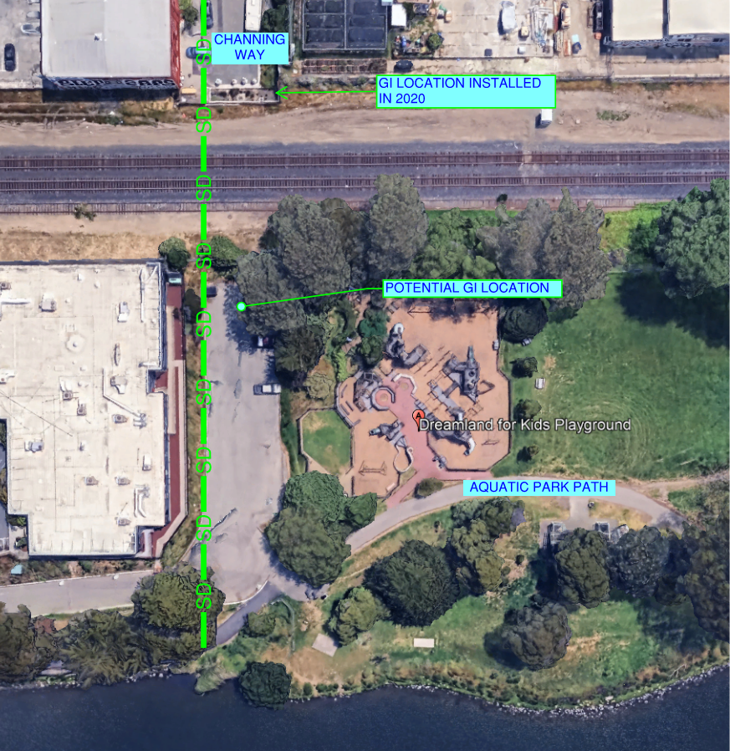
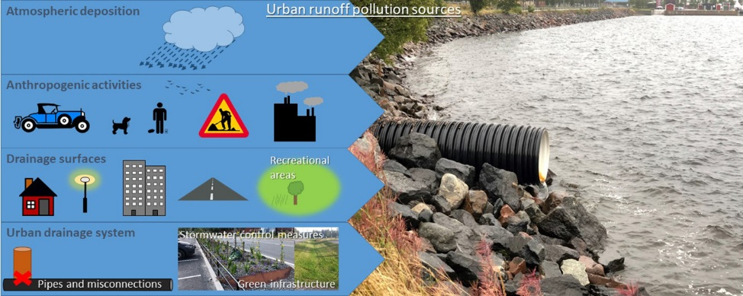
Green Infrastructure Opportunity
Dreamland Playground adjacent to one of the City’s storm drain outfalls to Aquatic park.
Contributing sources of pollutants:
Illegal dumping
Light industrial uses
Commercial uses
Fertilizers
Good candidate for bioretention/flow-through planter installation.
Attempts taken to begin incorporating green infrastructure in 2020 but limited space yielded limited treatment areas

Slide 4
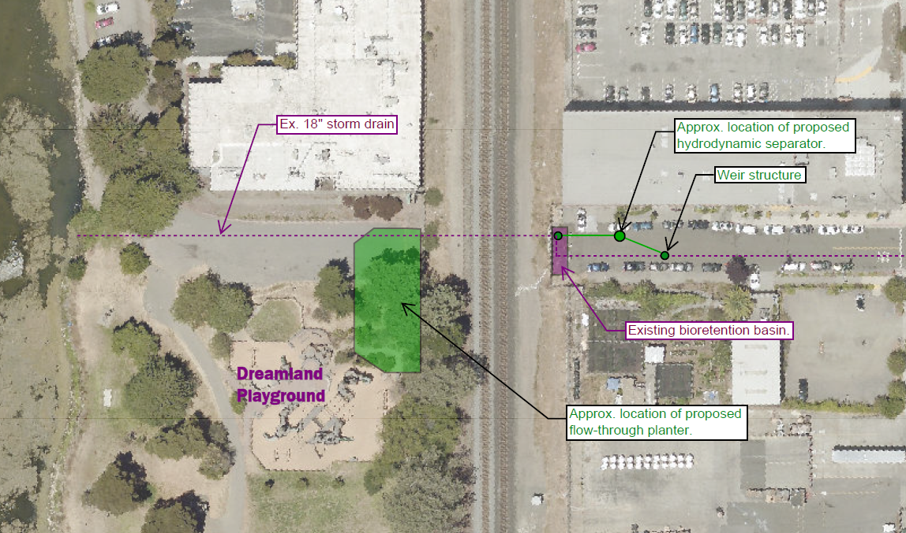
Proposed Improvements – Channing watershed

Slide 5
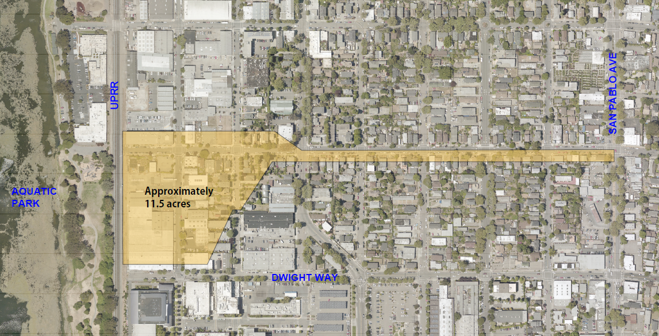
Channing Watershed

Slide 6
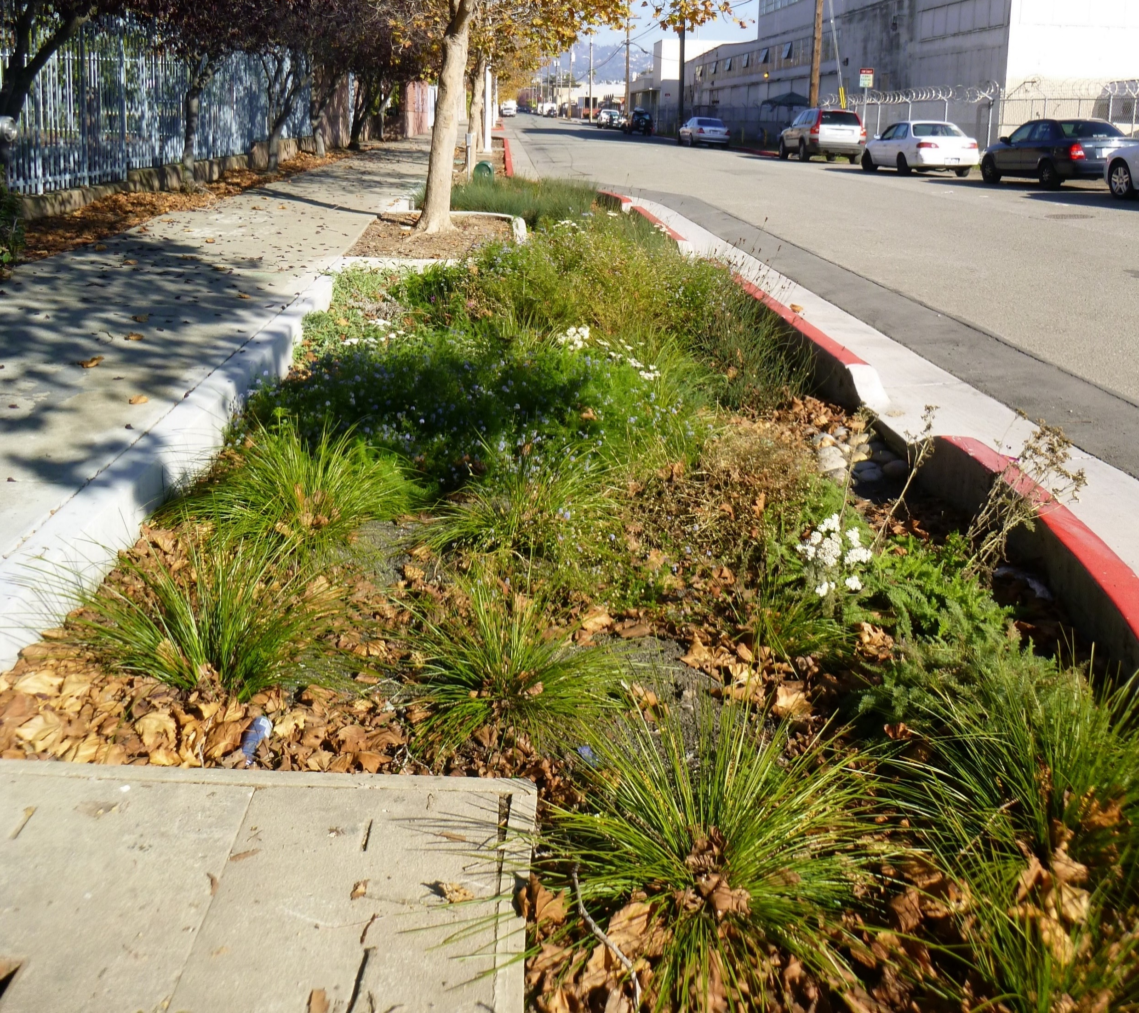
Bioretention/Flow-through planters
Removes pollutants from stormwater
Filtration
Uptake by vegetation
Decomposing and breakdown of pollutants by microbes and fungi
Specially designed soil media
Achieves design infiltration rate of at least 5 inches/hour
Supports plant growth

Slide 7
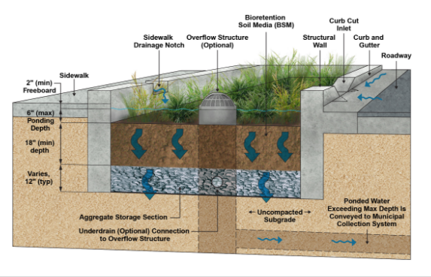
Bioretention basins
Typically section consists of:
6” ponding storage above biotreatment soil
18” Biotreatment Soil Mix
Permeable rock layer
Overflow drainage structure can be included to direct runoff to the public storm drain system in significant storm events
San Francisco Water Power Sewer Green Infrastructure Construction Guide Book

Slide 8
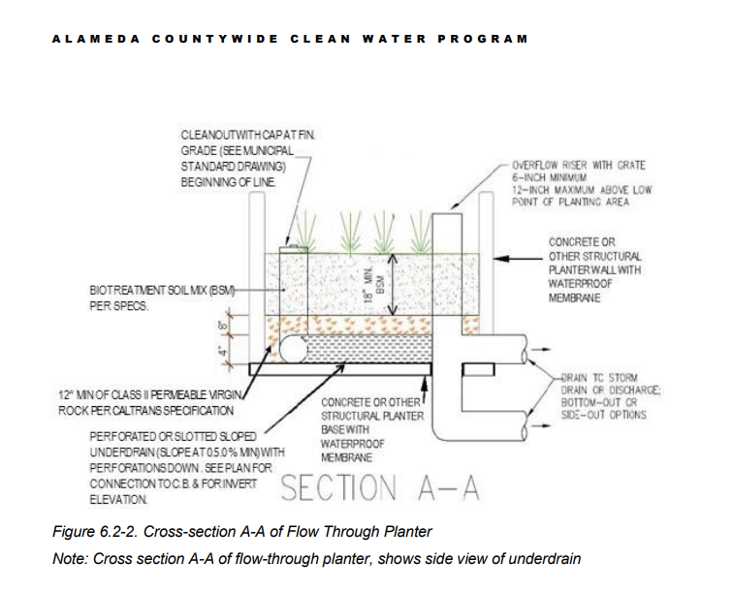
Flow-through planters
Unlike bioretention basins, flow-through planters do not allow infiltration into the native soil below.

Slide 9
Project Schedule
Construction deadline to receive Grant Funding is 2027
Construction tentatively expected in 2026.

